Slide 1

Reconstruction and estimation of Phylogenetic tree

Slide 2
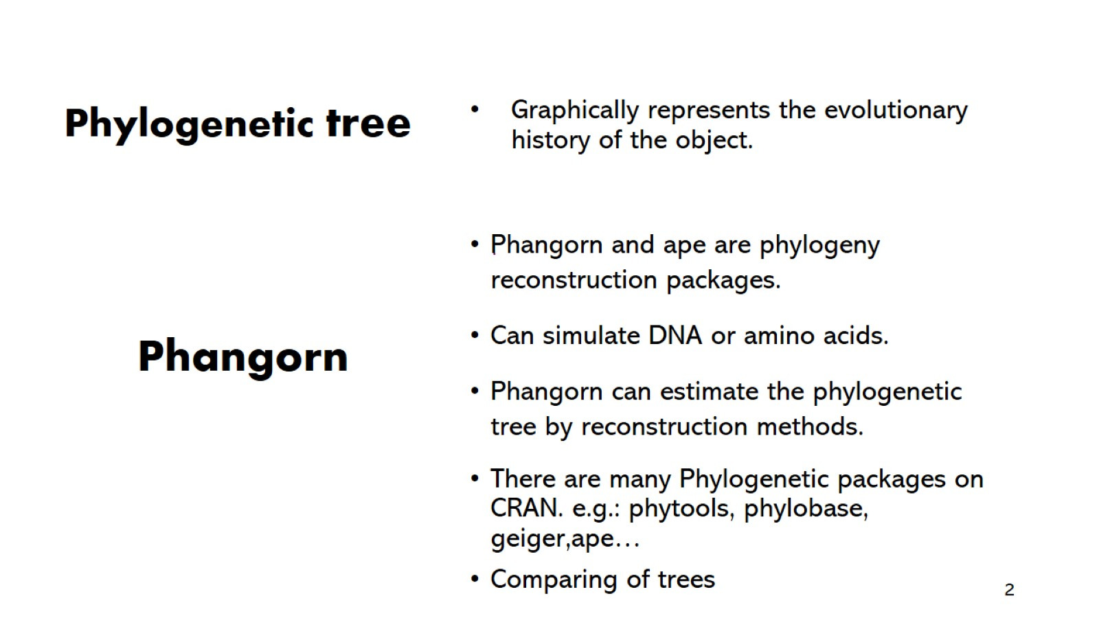
Graphically represents the evolutionary history of the object.

Slide 3
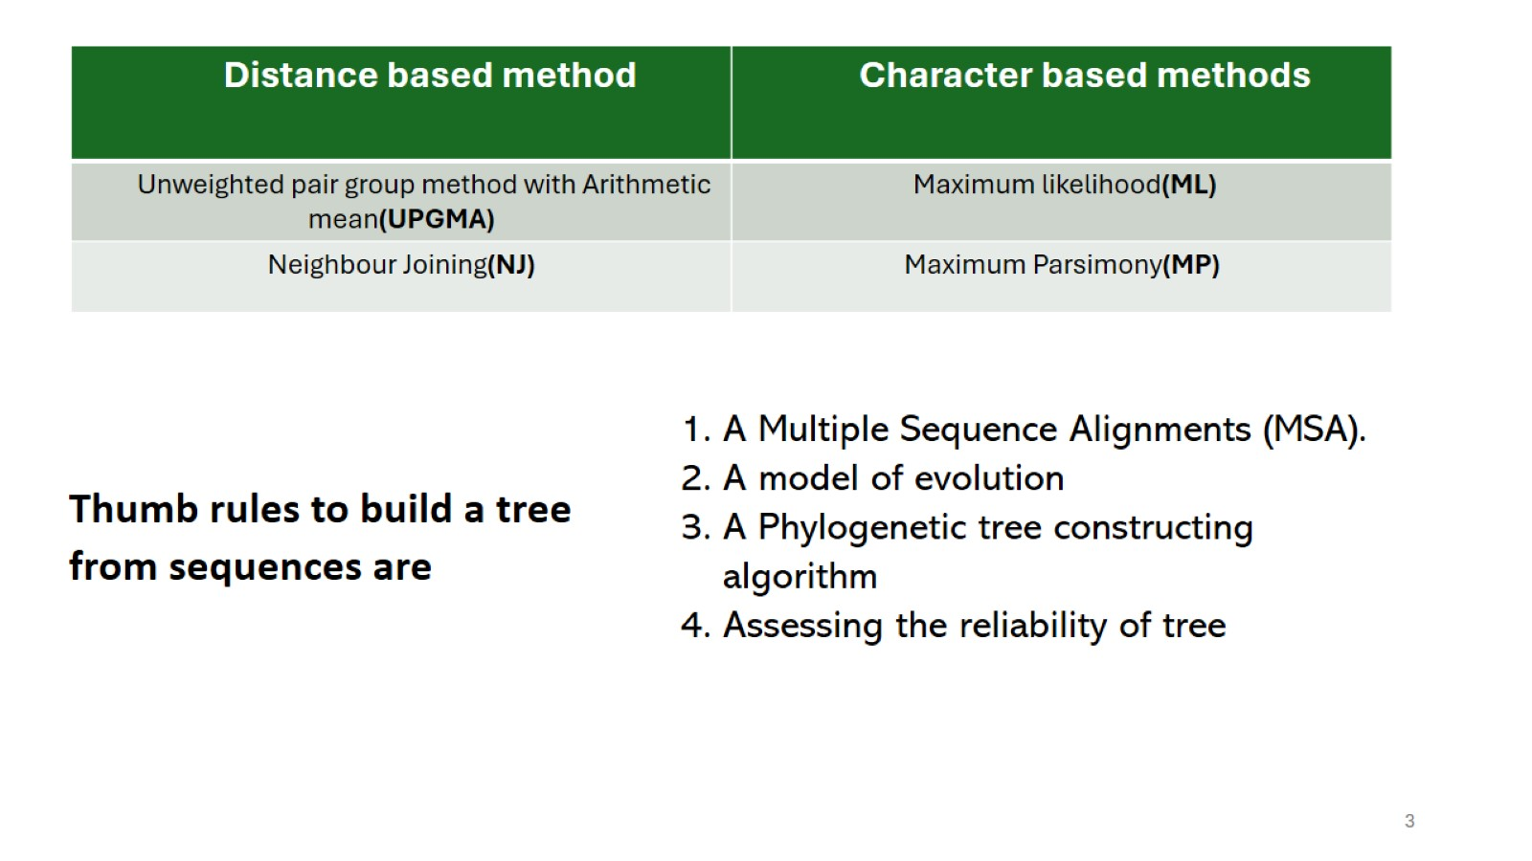

Slide 4
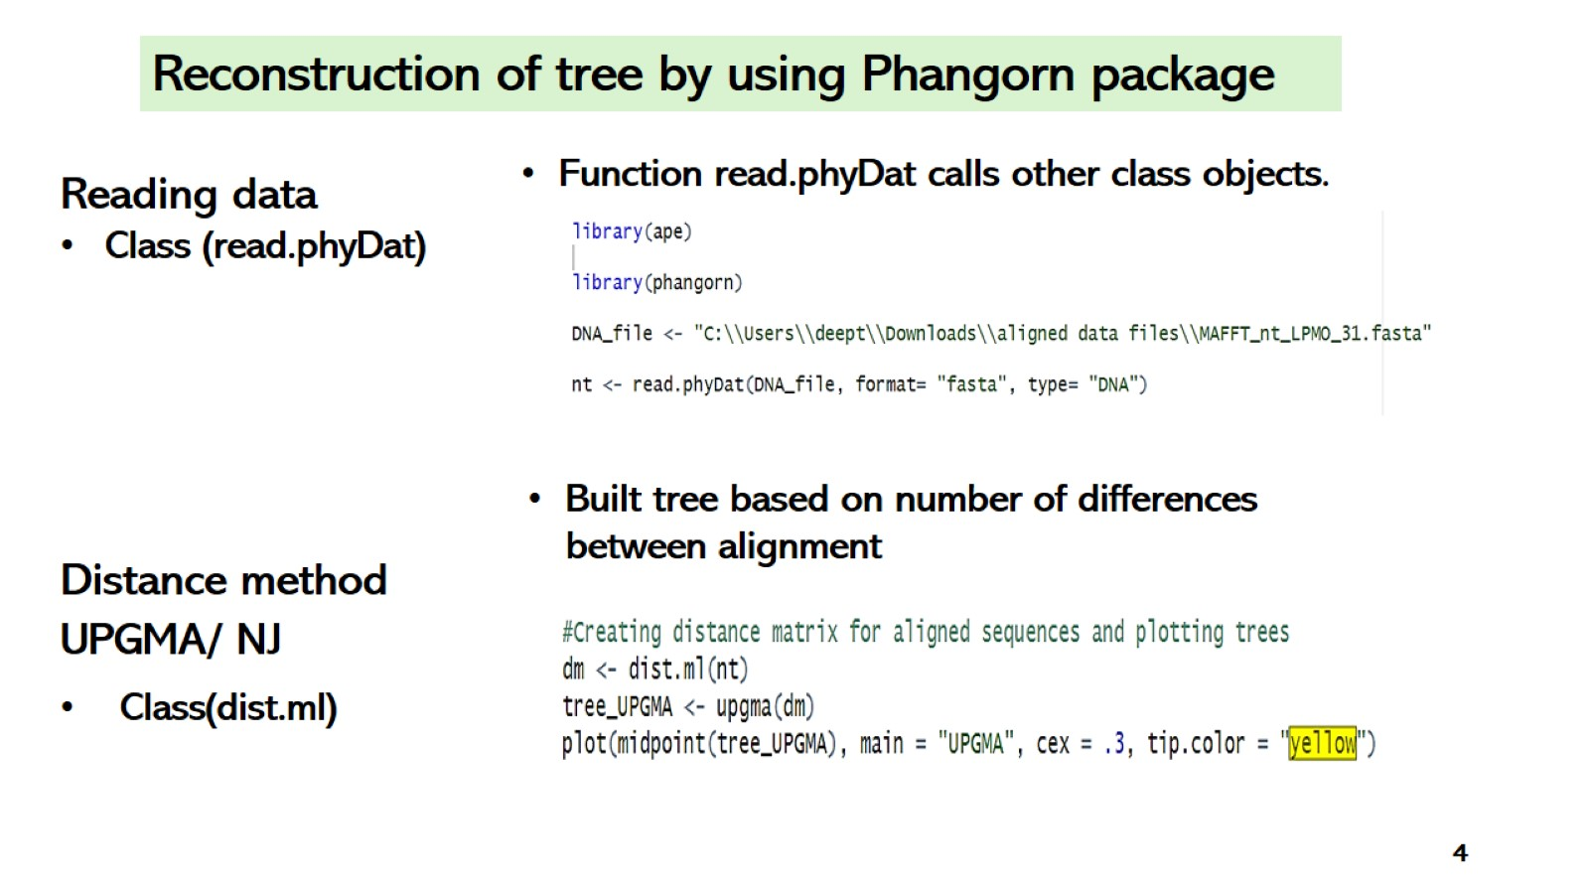

Slide 5
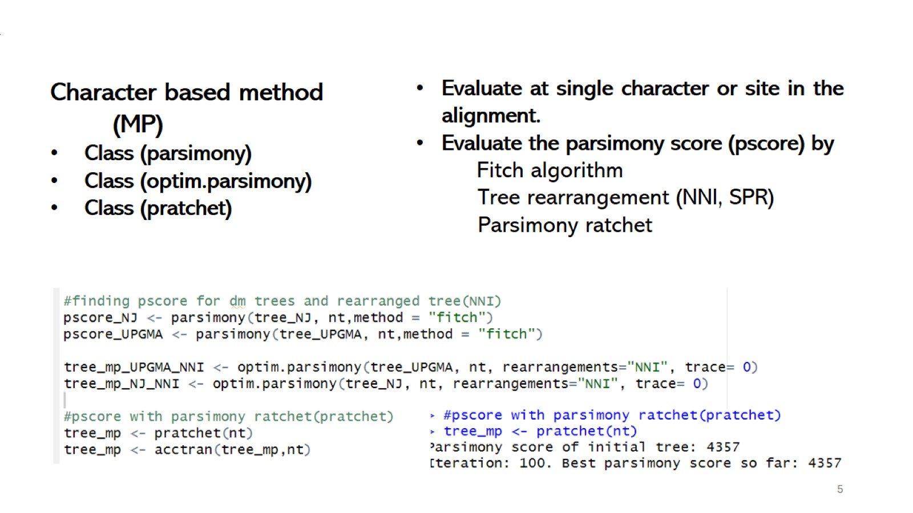

Slide 6
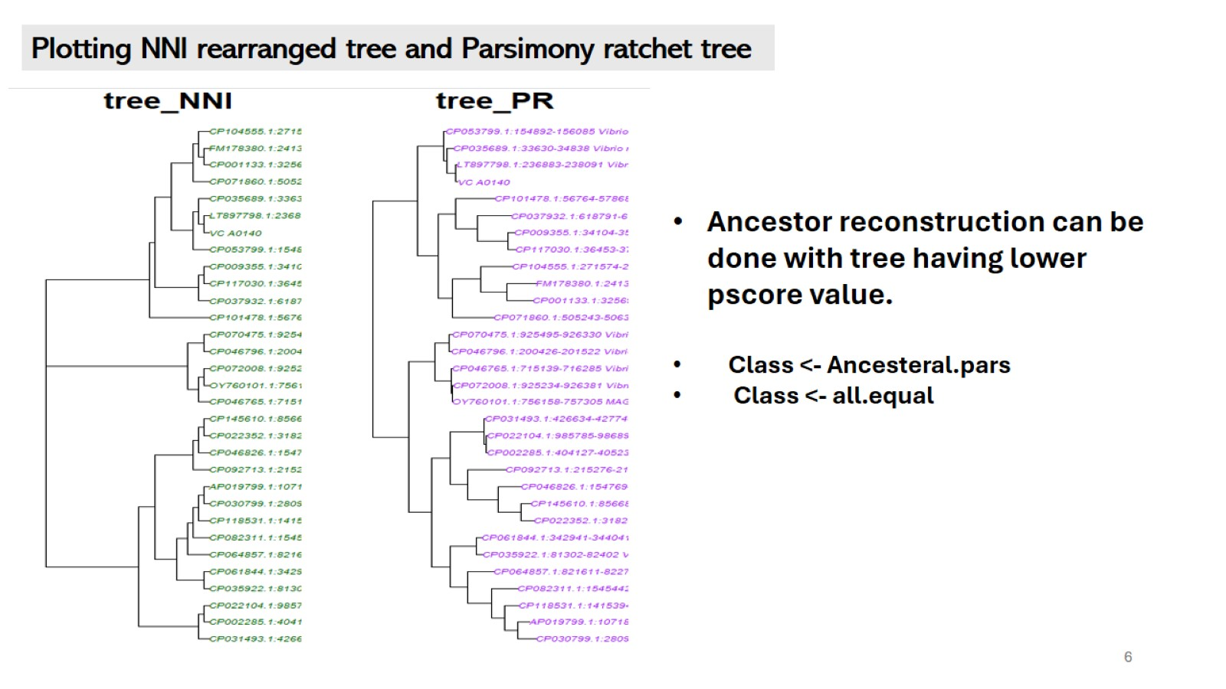

Slide 7
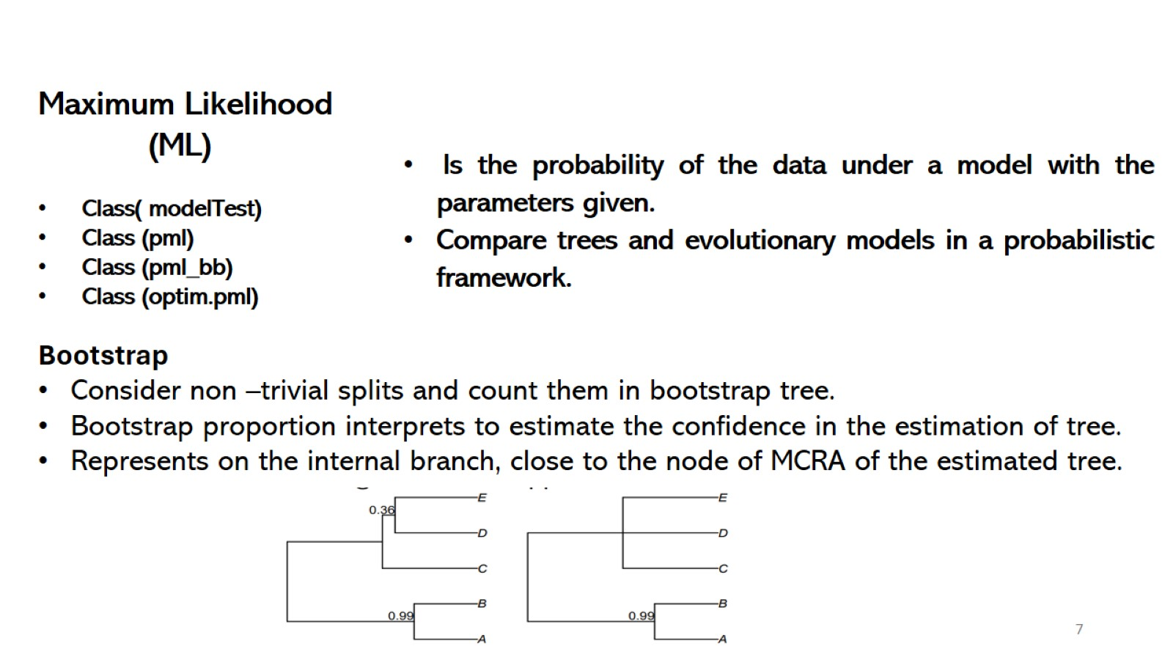

Slide 8
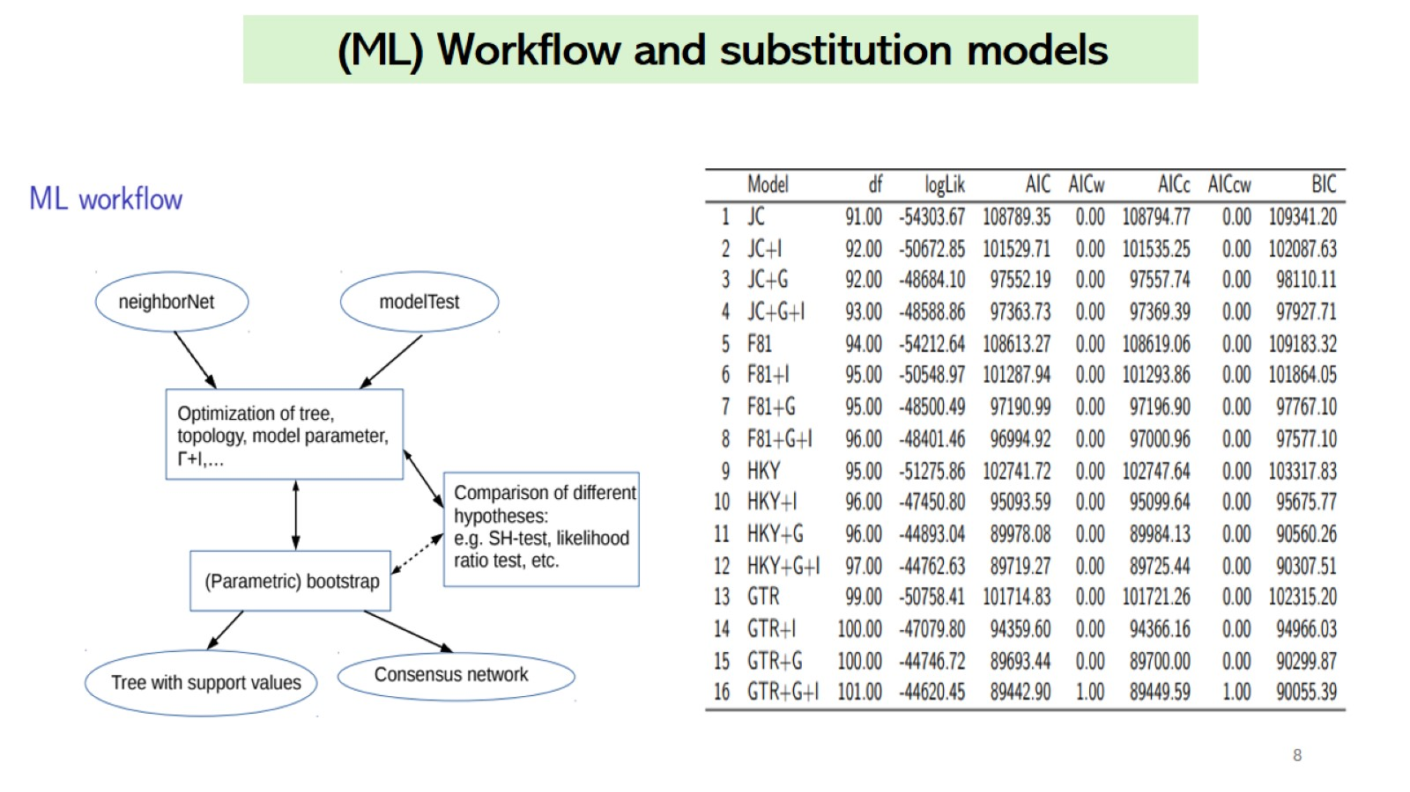

Slide 9
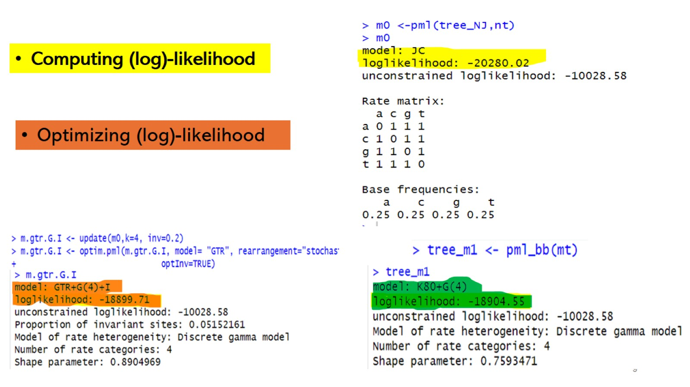

Slide 10
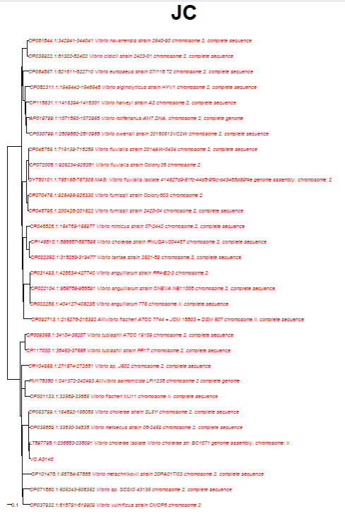
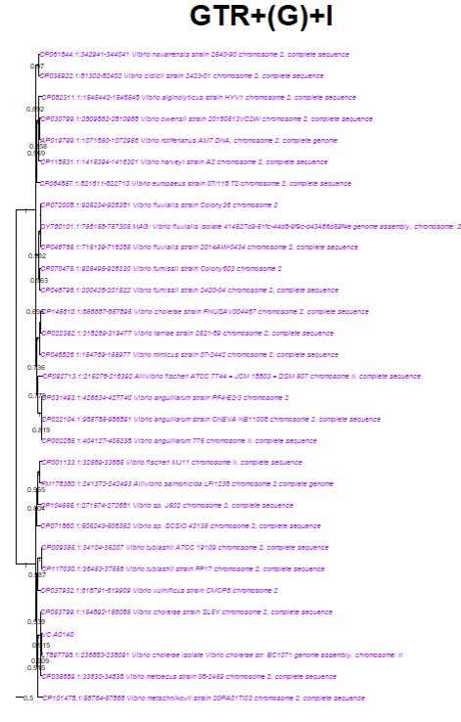
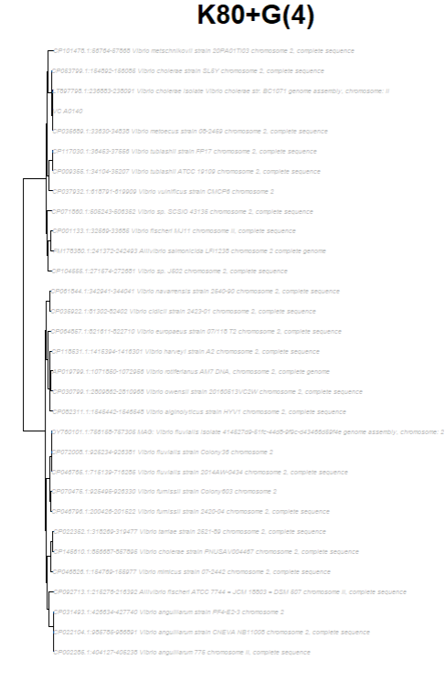
Plotting (log)likelihood estimated trees for different models

Slide 11
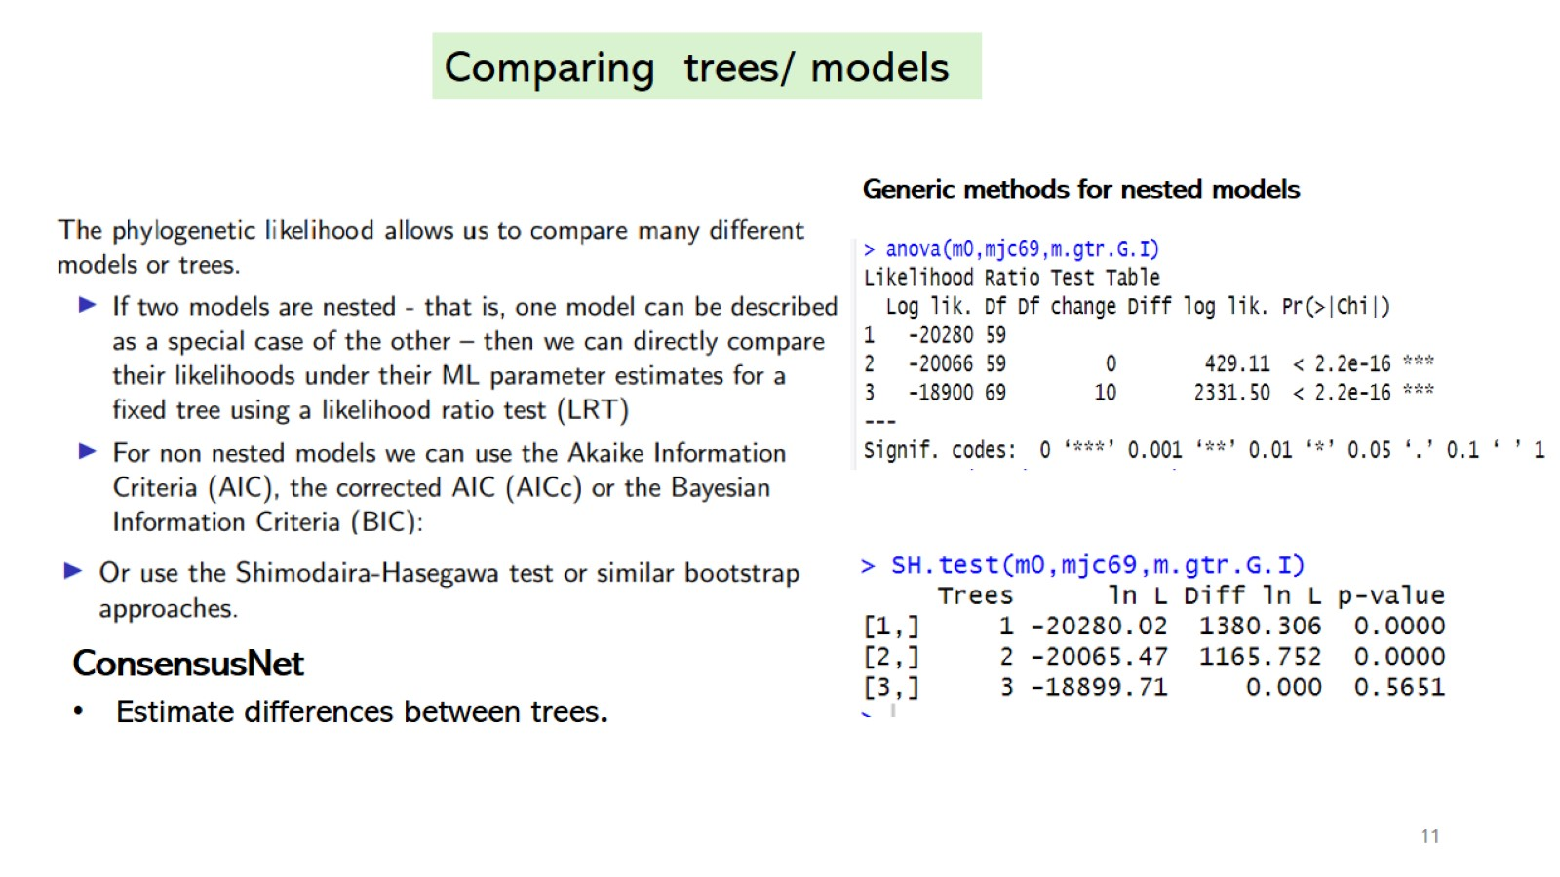

Slide 12
Plotting in RStudio
Shorten sequence names, plot trees, modify and compare them

Slide 13

# Install phangorn package in RStudio
> install.packages("remotes")
> install.packages('phangorn', repos = c('https://klausvigo.r-universe.dev', 'https://cloud.r-project.org‘))
> library(phangorn)

Slide 14
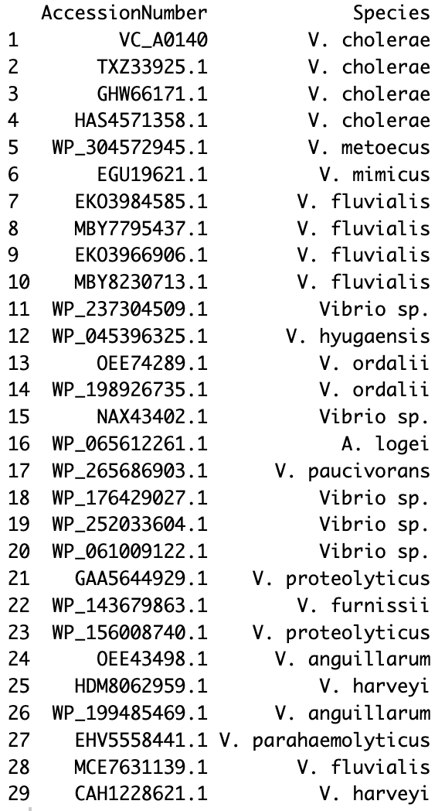
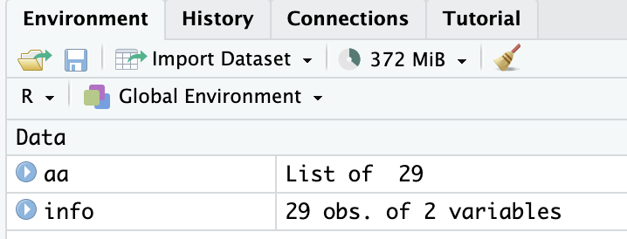
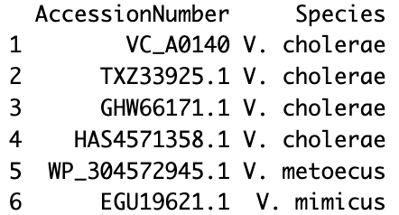
# Shorten sequence names
> read.csv("iqtree/aaSpeciesNames.csv")
> read.phyDat("iqtree/MAFFT_aa_LPMO.FASTA", format="fasta", type="AA")
> info <- read.csv("iqtree/aaSpeciesNames.csv")
> aa <- read.phyDat("iqtree/MAFFT_aa_LPMO.FASTA", format="fasta", type="AA")
> head(info)

Slide 15
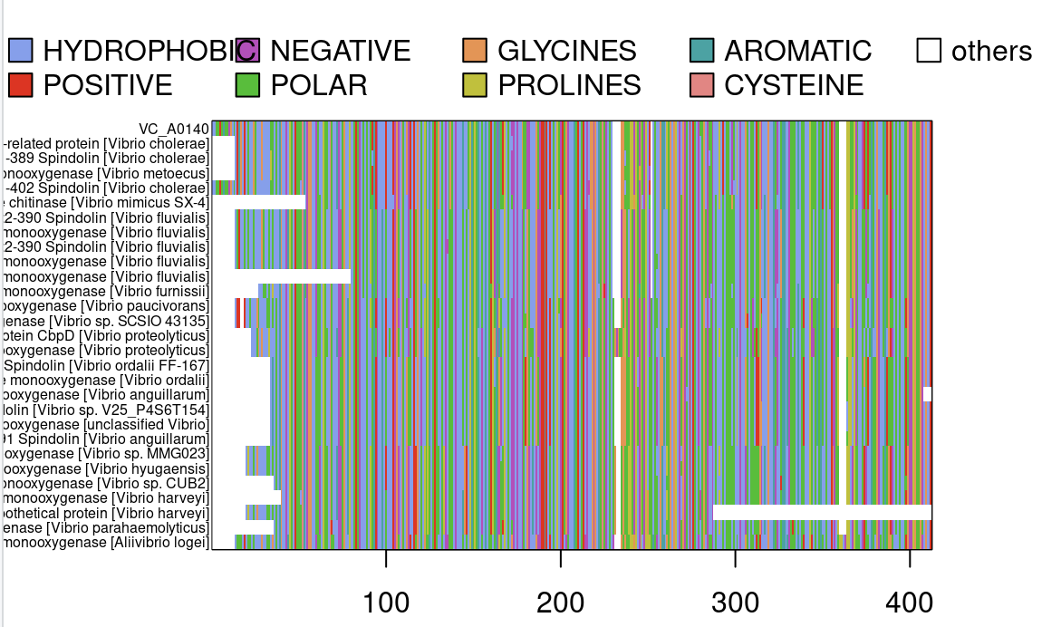
# Alignment – Long sequence names
> par(mar = c(4,6,4,4))
> image(aa, scheme="Clustal", cex=.5)
Sequence names are too long! We want to shorten them to only show the Accession Number.

Slide 16
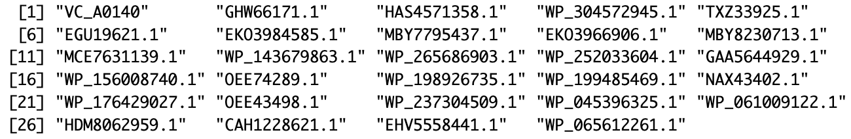
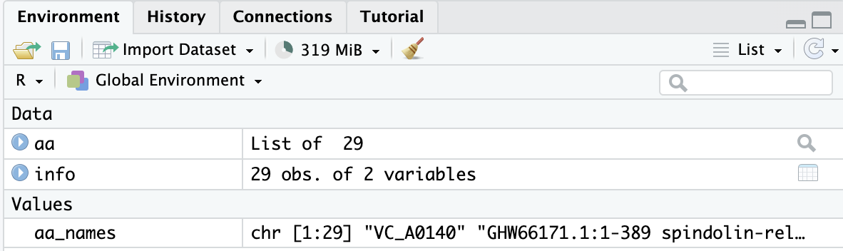
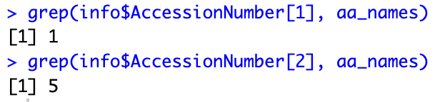
# Shorten sequence names
> names(aa)
> aa_names <- names(aa)
> grep(info$AccessionNumber[1], aa_names)
> grep(info$AccessionNumber[2], aa_names)
„grep, grepl, regexpr, gregexpr, regexec and gregexec search for matches to argument pattern within each element of a character vector: they differ in the format of and amount of detail in the results“

Slide 17
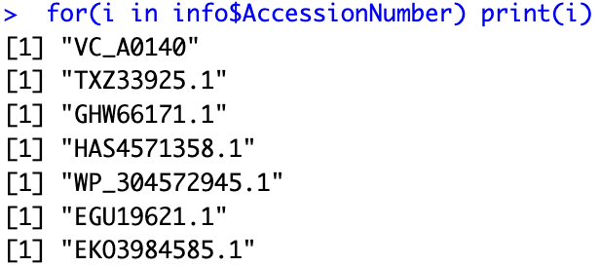
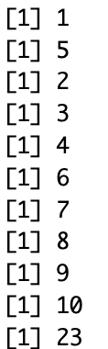
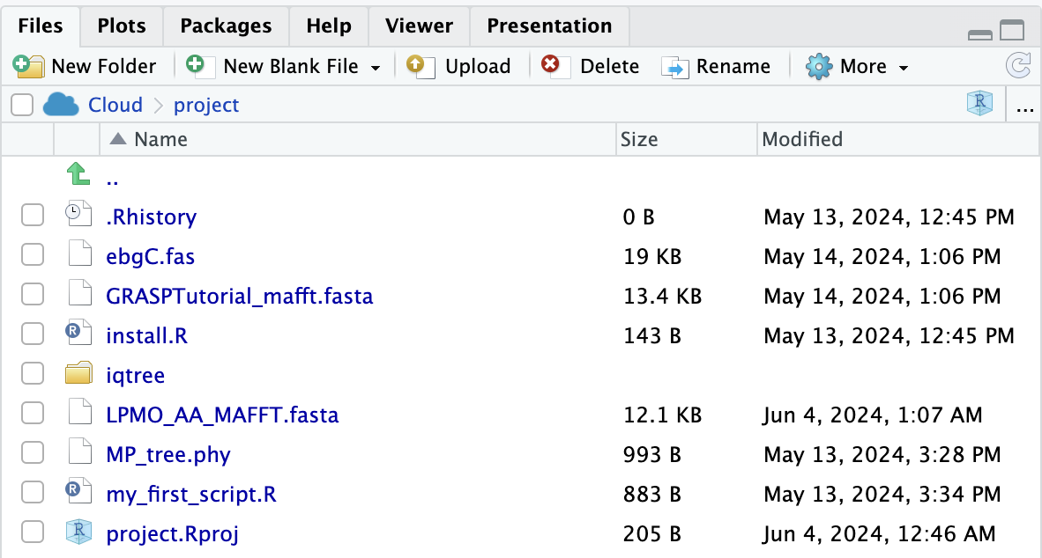
# Shorten sequence names
> for(i in info$AccessionNumber) print(i)
> for(i in info$AccessionNumber) {
pos <- grep(i, aa_names)
print(pos)
}
> for(i in info$AccessionNumber) {
pos <- grep(i, aa_names)
aa_names[pos] <- i
}
> names(aa) <- aa_names
> names(aa)
> write.phyDat(aa, "LPMO_AA_MAFFT.fasta")
for-loop
Creates file in wd

Slide 18
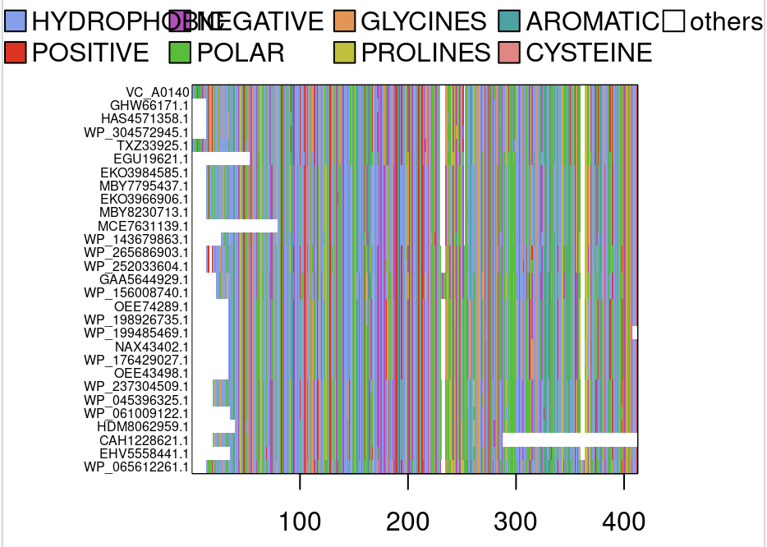
# Alignment – Shortened sequence names
> image(aa, scheme="Clustal", cex=.5)
Sequence names now only show the Accession Number.

Slide 19
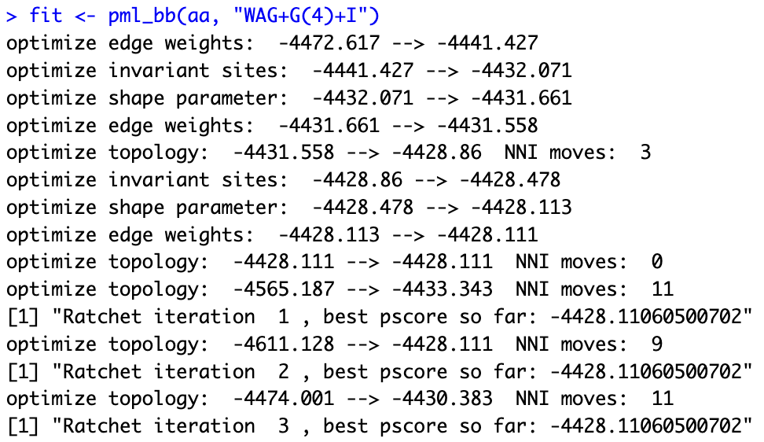
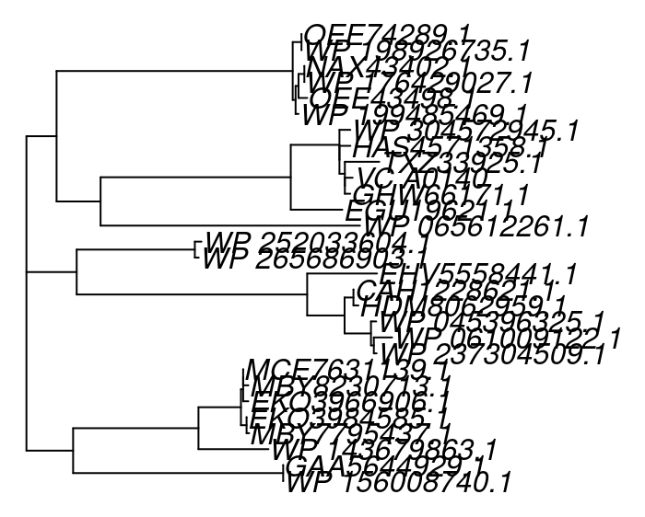
# Generate and plot tree #1
Maximum Likelihood method (phangorn)
> mt <- modelTest(aa)
> mt
> fit <- pml_bb(mt)
or
> fit <- pml_bb(aa, "WAG+G(4)+I")
> tree_ml <- fit$tree
> plot(tree_ml)

Slide 20
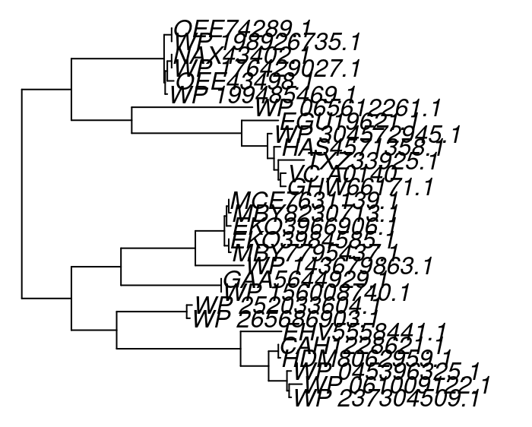
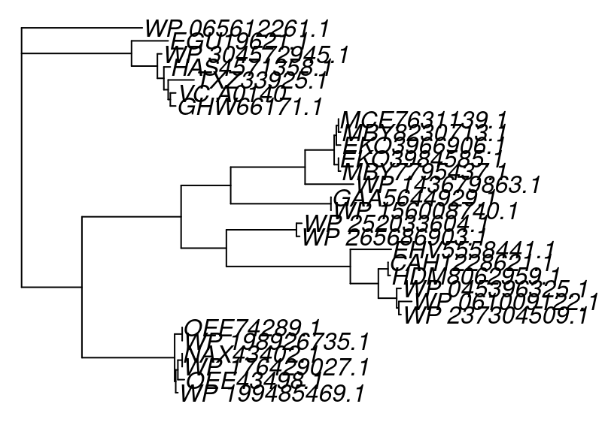
# Modify tree plot
#add branch lengths
> tree_ml <- acctran(tree_ml, aa)
#make tree nicer
> tree_ml <- midpoint(tree_ml)
#A. logei as outgroup
> tree_outgroup <- root(tree_ml, "WP_065612261.1")
> plot(tree_outgroup)

Slide 21
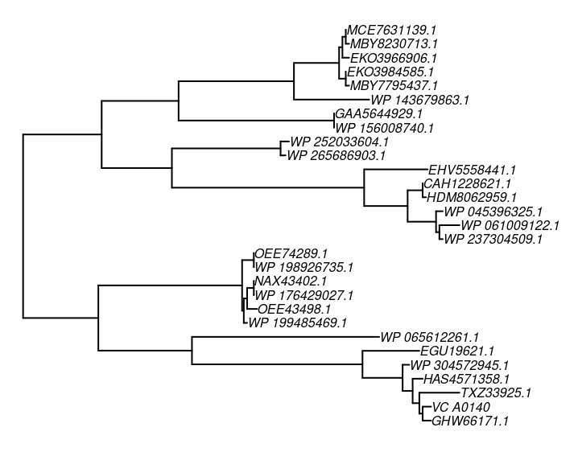
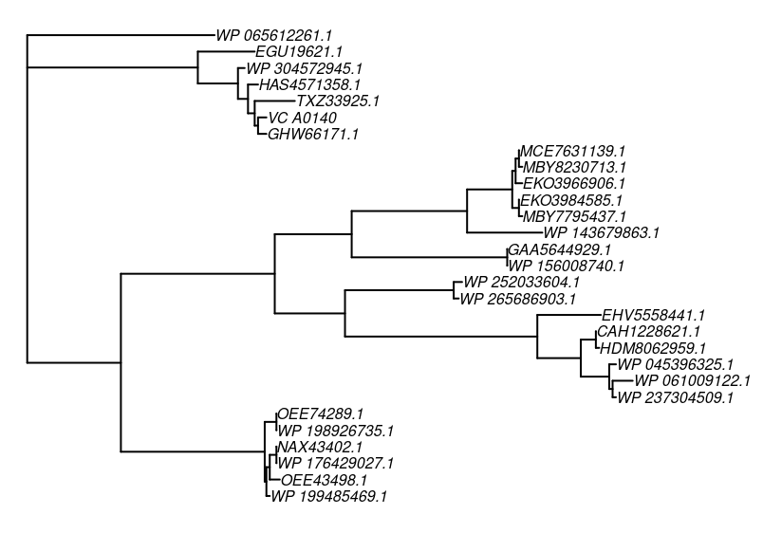
# Modify tree plot – Font size
> plot(tree_ml, cex=.5)
> plot(tree_outgroup, cex=.5)

Slide 22
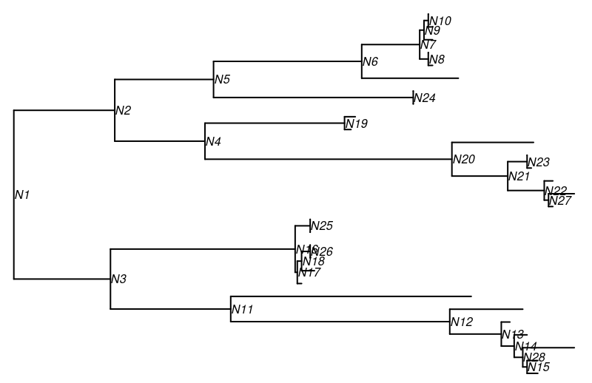
# Modify the plot – Node/Tip labels
> tree_wlabel <- makeNodeLabel(tree_ml, prefix="N")
> plot(tree_wlabel, show.tip.label = FALSE, show.node.label = TRUE, cex=.5)

Slide 23
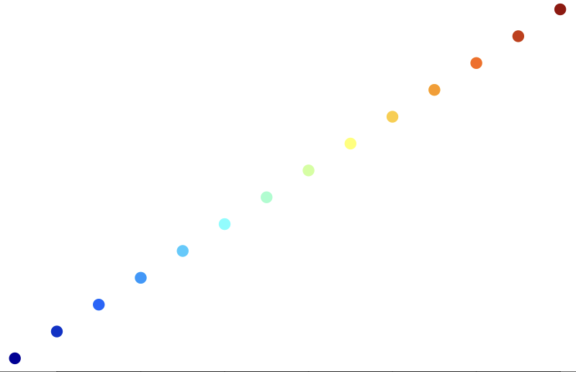
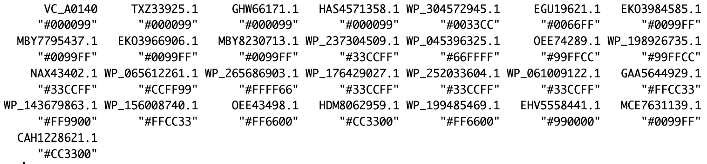
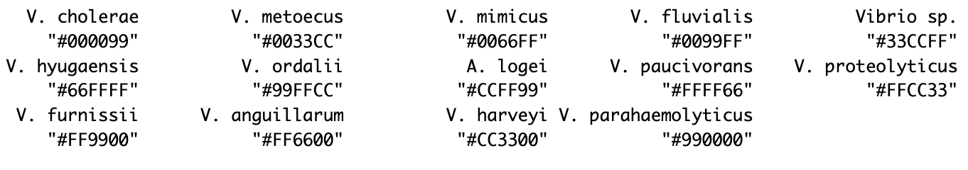
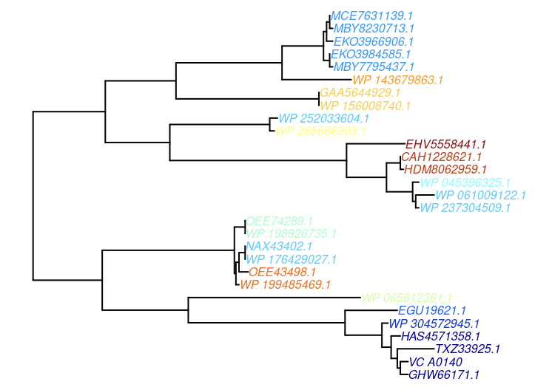
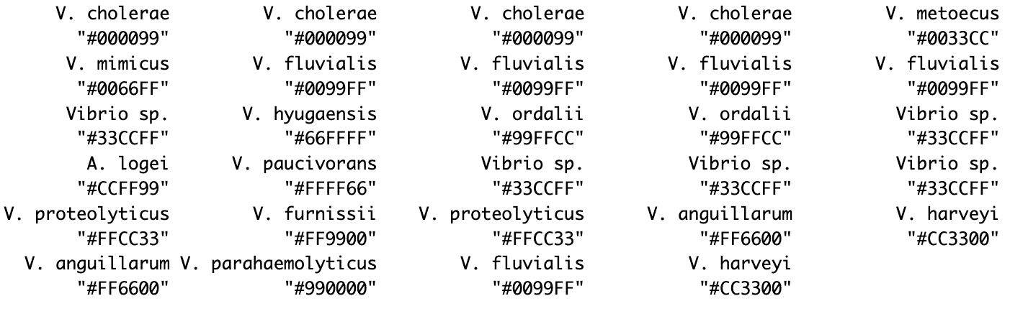
# Modify tree plot – Color tip labels
> col <- rgb.tables(14)
> names(col) <- unique(info$Species)
> col
> names(col) <- unique(info$AccessionNumber)
> col
> plot(tree_ml, tip.color = col[tree_ml$tip.label], cex=.5)
> col <- col[info$Species]
> col

Slide 24
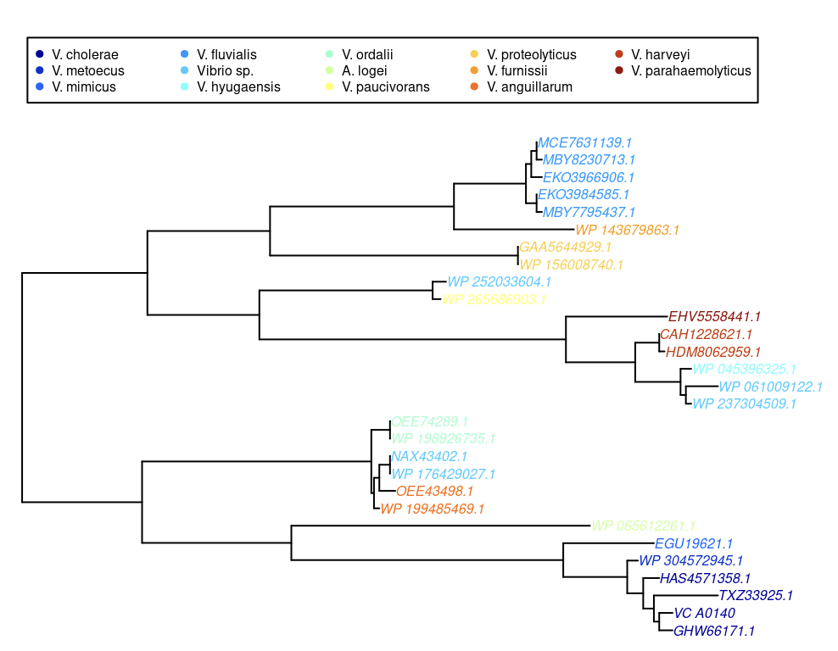
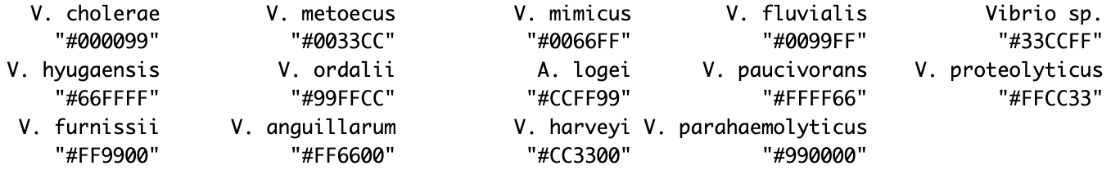
# Modify tree plot – Add a legend
> legend(1,35,names(col_Sp), col=col_Sp, pch=19, ncol=5, cex=.5)
> col_Sp <- rgb.tables(14)
> names(col_Sp) <- unique(info$Species)
> col <- col_Sp[info$Species]
> names(col) <- unique(info$AccessionNumber)
> col_Sp

Slide 25
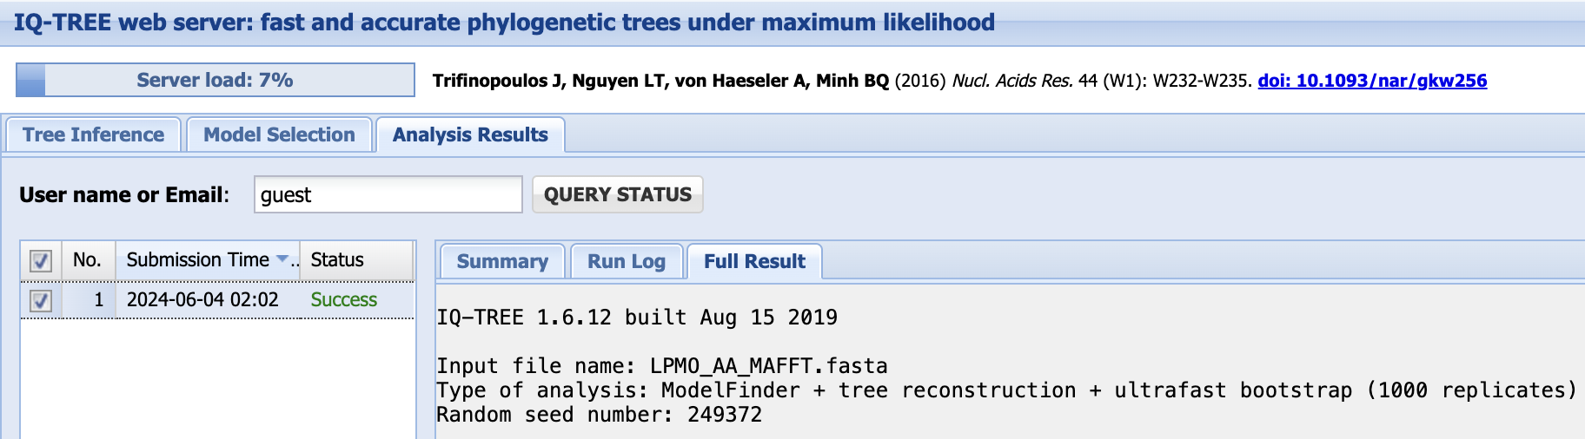
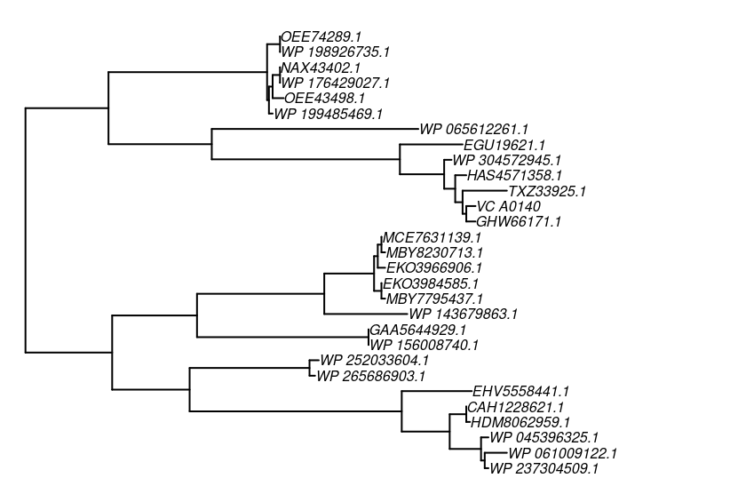
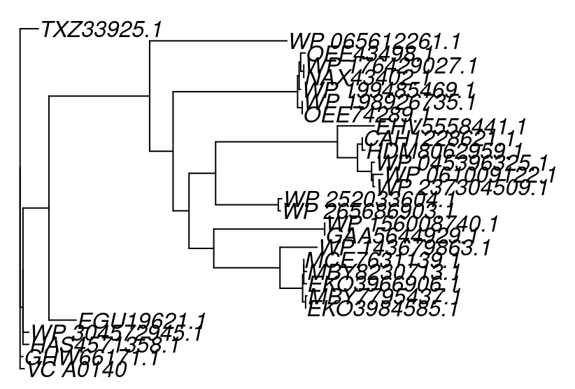
# Generate, plot and improve tree #2
Maximum Likelihood method (IQ-TREE)
#add branch lengths
> tree_ml2 <- acctran(tree_ml, aa)
#midpoint root tree
> tree_ml2 <- midpoint(tree_ml)
#font size
> plot(tree_ml2, cex=.5)
(VC_A0140:0.0074362102,GHW66171.1:0.0051755778,((HAS4571358.1:0.0104597361,(WP_304572945.1:0.0103933862,(EGU19621.1:0.0488020888,(((((((EKO3984585.1:0.0000020115,MBY7795437.1:0.0024835179)87.3/97:0.0053584301,(EKO3966906.1:0.0049693298,(MBY8230713.1:0.0049772517,MCE7631139.1:0.0000021813)0/67:0.0000021813)73.6/89:0.0021138980)96.7/99:0.0405066199,WP_143679863.1:0.0665423519)99.8/100:0.1185441505,(GAA5644929.1:0.0000021813,WP_156008740.1:0.0000021813)100/100:0.1985757851)61.5/41:0.0443535819,((WP_265686903.1:0.0037255118,WP_252033604.1:0.0062864467)100/100:0.1122133140,((((WP_237304509.1:0.0026017825,WP_061009122.1:0.0173597053)74.8/94:0.0027369115,WP_045396325.1:0.0049963598)95.4/91:0.0251195324,(HDM8062959.1:0.0047043827,CAH1228621.1:0.0000022461)83.2/95:0.0084355547)83.6/81:0.0359831535,EHV5558441.1:0.0657393567)100/100:0.2180746053)79.3/57:0.0476745340)68.8/33:0.0285559940,((OEE74289.1:0.0000021813,WP_198926735.1:0.0000021813)88.8/97:0.0083139959,(WP_199485469.1:0.0027500435,((NAX43402.1:0.0000021813,WP_176429027.1:0.0000020039)87.2/99:0.0055348236,OEE43498.1:0.0082954555)77.1/93:0.0027649318)73.6/85:0.0027637573)100/100:0.2229536241)58.8/71:0.0419207557,WP_065612261.1:0.2458492533)100/100:0.1803159832)96.4/99:0.0464964338)0/60:0.0000022257)70.9/75:0.0051578982,TXZ33925.1:0.0328232477)0/74:0.0000021154);
> tree_ml2 <- read.tree("LPMO_AA_MAFFT.fasta.treefile")
> plot(tree_ml2)

Slide 26
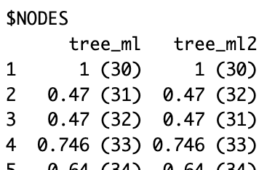
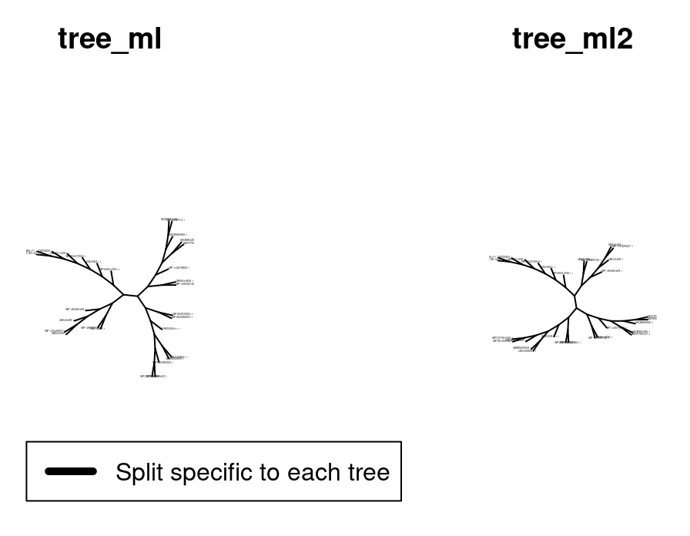
# Compare trees #1 (tree_ml) and #2 (tree_ml2)
> comparePhylo(tree_ml, tree_ml2, commons=FALSE, plot = TRUE, cex=.1)
=> Comparing tree_ml with tree_ml2. Both trees have the same number of tips: 29. Both trees have the same tip labels. Both trees have the same number of nodes: 28. Both trees are rooted. Both trees are not ultrametric. Node labels of clades in common between both trees: see ..$NODES (node number in parentheses). 27 splits in common.
For all 28 nodes

Slide 27
Thank you for your attention! ☺

Slide 28
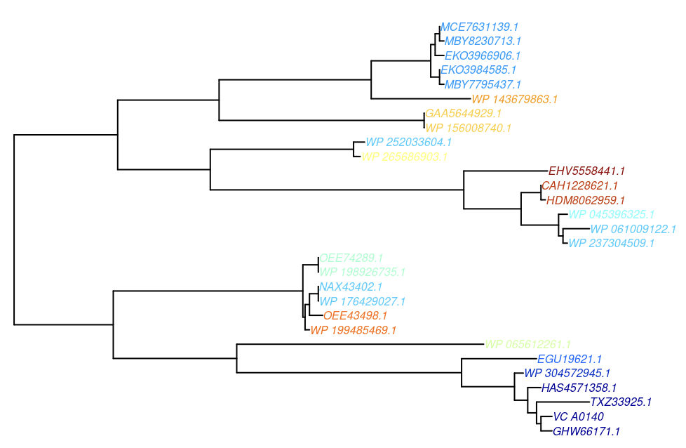
Annex
Colored tip labels
legend
install.packages("colorRamps")
library(colorRamps)
plot(1:14, col=rgb.tables(14), pch=19)
> par(mar=c(1,1,1,1))
> plot(tree_ml, tip.color = col[tree_ml$tip.label], y.lim = c(1,35), cex=.5)

Slide 29
Comments
Maximum likelyhood trees come with edge lengths → you don‘t need to add them

